Slide 1
Team Spark
STATISTICAL DATA ANALYSIS ON CRIMES AGAINST WOMEN
Presented By:-
Rishit Nagar
Adesh Sadekar

Slide 2
AGENDA
In this project we try to depict the growth or fall of the variety of crimes done on women, such as abduction, dowry ,rape etc.
With our data set of the crimes against women from the year 2001-2014, we would portray crimes in different districts of India.
The given values in our dataset might not be the same as the actual number of cases that happened in our country.

Slide 3
EXPECTED OUTCOME
Main aim of working on this project is to reflect the situation of women in our society and raise concern about this matter
Through this project we would statistics in form of graphs so that every-time one looks at it they should remind themselves of the wrongs in our society and
A motivation for those women who are scared to come out in public, will have courage to come out as other women and fight for their rights.

Slide 4
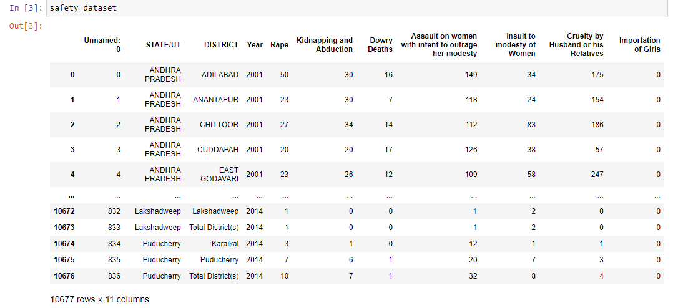
DATASET: CRIME AGAINST WOMEN(2001-2014)
Source: Kaggle

Slide 5
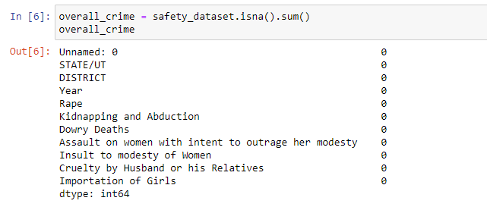
DATA PREPARATION AND CLEANING
A basic step of data cleaning is to remove null values

Slide 6

UNIQUE NUMBER OF DISTICTS
Classifying the data-set into unique districts
India has 748 districts,which means there is messy or false data in a huge amount, in this case, we better drop the column "District" and also "Unnamed: 0", as it is of no use, in our data analysis process.

Slide 7
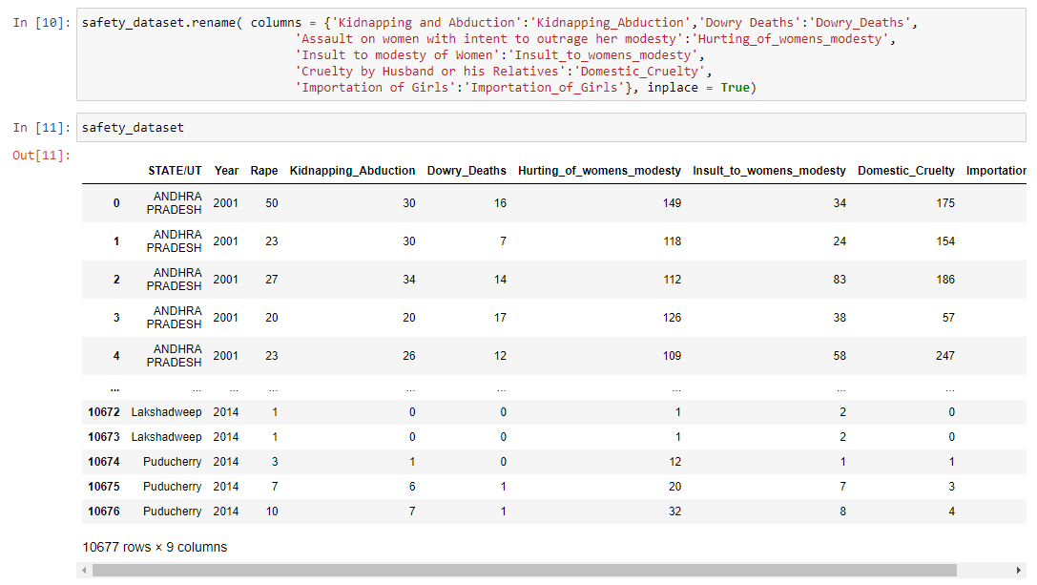
RE-NAMING COLUMNS OF DATA-SET FOR ANALYSIS

Slide 8
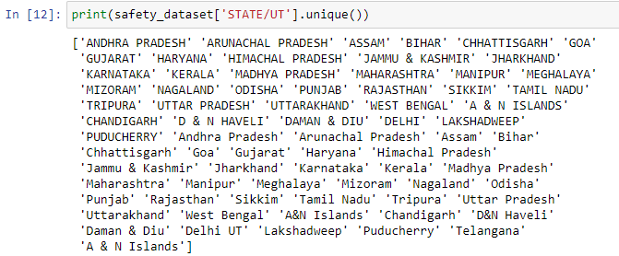
PRINTING THE UNIQUE STATE/UT’s FROM THE DATA-SET
Analyzing the data of the column "STATE/UT", for that let's find out the names of all the states/UT through .unique()

Slide 9
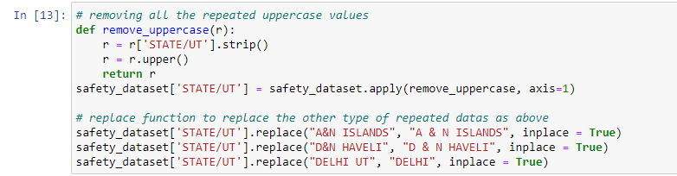
We can see from above that there are lot many repeated data, like some of them are repeated again by using capital letters and some of them have issues with space too, like A&N Islands and also Delhi has been repeated again by mentioning it as Delhi UT

Slide 10
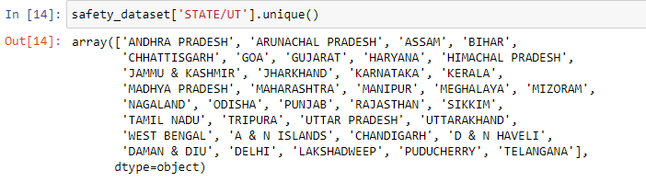
LET’s GO THROUGH OUR DATA

Slide 11

CHECK TOTAL NUMBER OF STATE’s AND UT’s

Slide 12
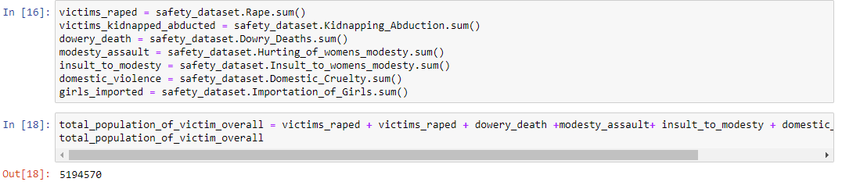
ANALYSIS AND VISUALIZATION
Find out the total population of women over the years, 2001-2014, who has been a victim of the crime based on their gender.
A sad and disturbing figure of 50+ lakhs

Slide 13
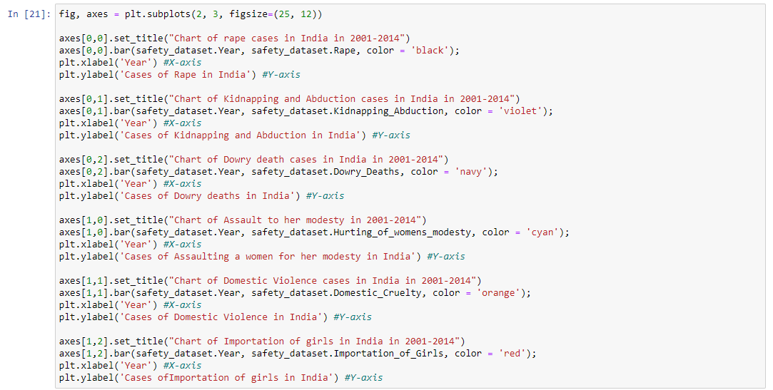
GRAPH ANALYSIS

Slide 14
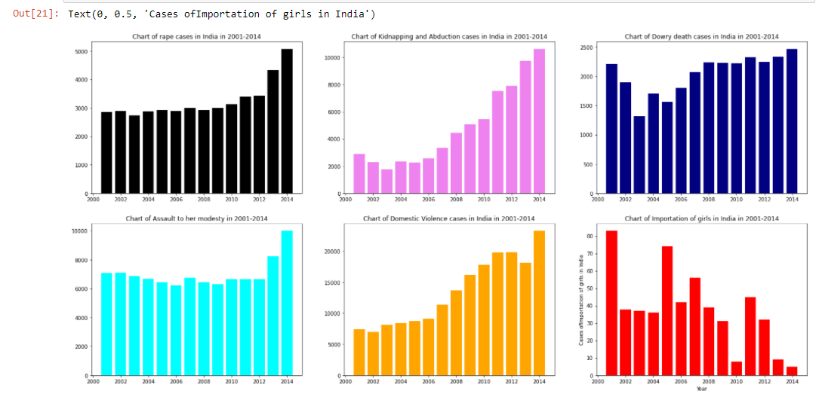

Slide 15
INFERENCE
Two things to be concluded from the above bar chart -
1) The cases have increased over the years.
2) 2014 has been the year, where violence against women was reported the maximum, under each of the cases like, rape, domestic violence etc, which is proved in the forth coming slides.

Slide 16
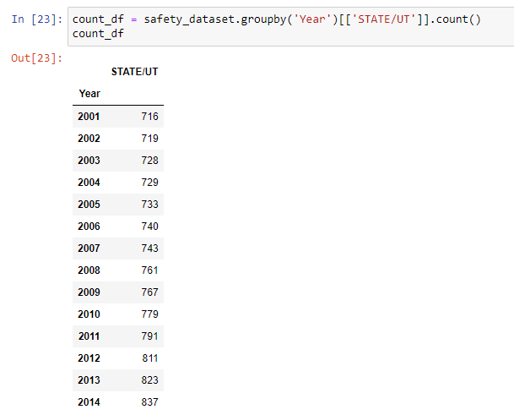
PROOF:

Slide 17
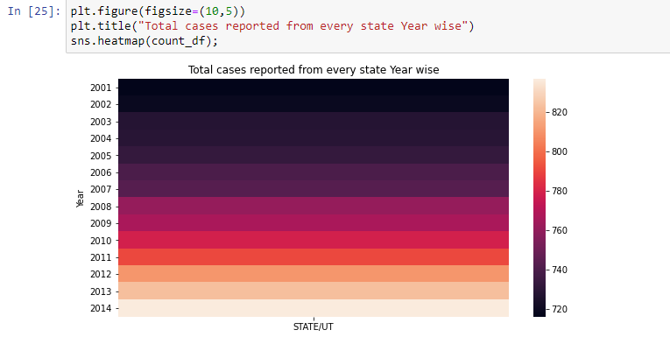
HEATMAP
Using seaborn to produce heatmap to represent how more cases from each state started coming up more frequently with each passing year.

Slide 18
Q/A ANALYSIS
We consider four main crimes for smooth analysis of our data-set
1.>Rape
2.>Kidnapping Abduction
3.>Dowry Deaths
4.>Importation of Girls

Slide 19
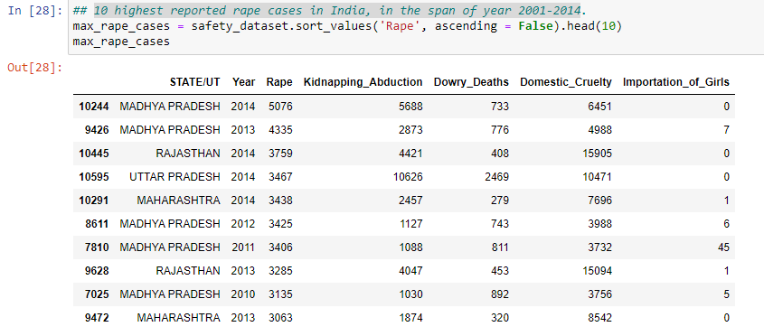
Q1. 10 highest reported rape cases in India, in the span of year 2001-2014
Inference: Madhya Pradesh has had the highest number of rape case in year 2014

Slide 20
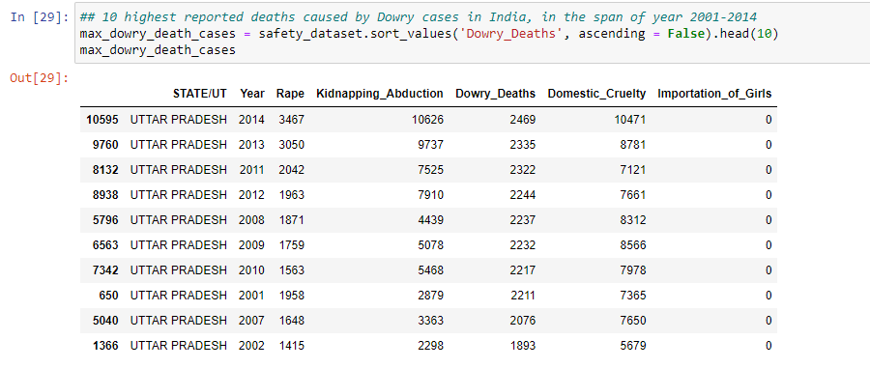
Q2. 10 highest reported deaths caused by Dowry cases in India, in the span of year 2001-2014
Inference: Uttar Pradesh has had the most number of reported dowry cases in year 2014

Slide 21
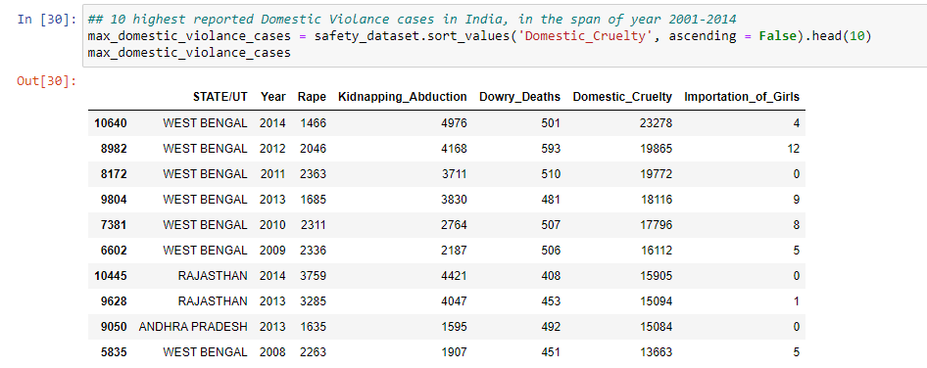
Q3. 10 highest reported Domestic Violence cases in India, in the span of year 2001-2014
Inference: West Bengal has had the most number of Domestic Violence cases in year 2014

Slide 22
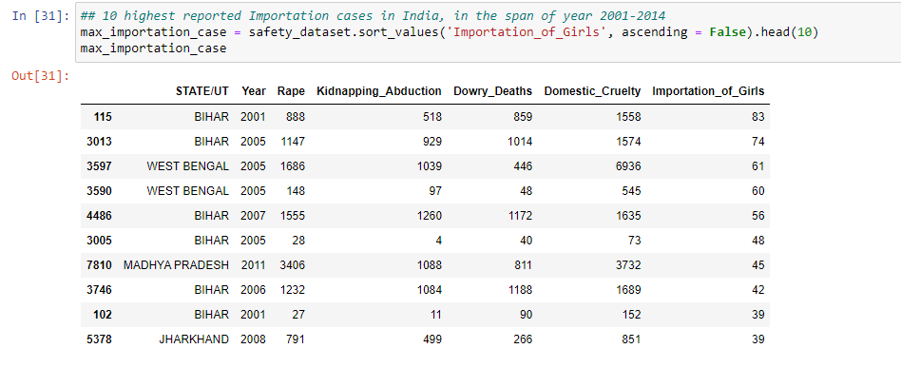
Q4. 10 highest reported Importation cases in India, in the span of year 2001-2014
Inference: Bihar has had the most cases of Importation in ` year 2001

Slide 23
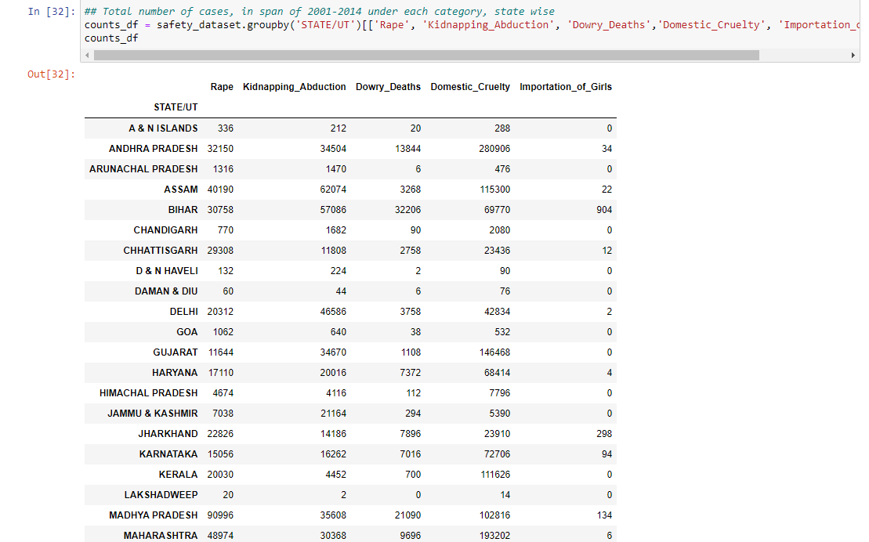
Total number of cases, in span of 2001-2014 under each category, state wise

Slide 24
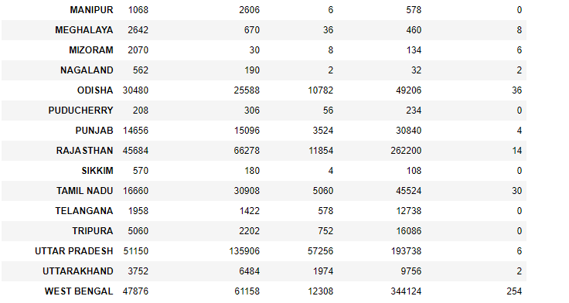

Slide 25
THE #TOP 5
Here comes the TOP 5 for the crimes in each state
Four main crimes:
1.>Rape
2.>Kidnapping Abduction
3.>Dowry Deaths
4.>Importation of Girls

Slide 26
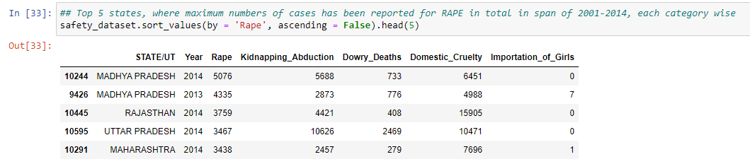
Top 5 states, where maximum numbers of cases has been reported for RAPE in total in span of 2001-2014
Inference: Madhya Pradesh has reported the highest number of rape cases in TOTAL in span of 2001-2014, where UP, Maharashtra, West Bengal and Rajasthan follows the list.

Slide 27
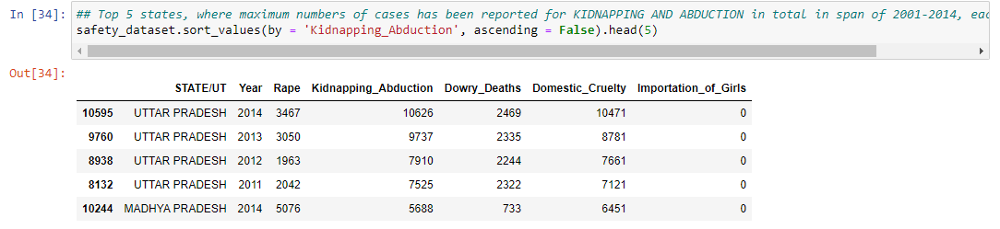
Top 5 states, where maximum numbers of cases has been reported for KIDNAPPING AND ABDUCTION in total in span of 2001-2014
Inference: Uttar Pradesh has reported the highest number of cases under "Kidnapping and Abduction" in TOTAL in span of 2001-2014, where Rajasthan, Assam, West Bengal and Bihar follows the list.

Slide 28
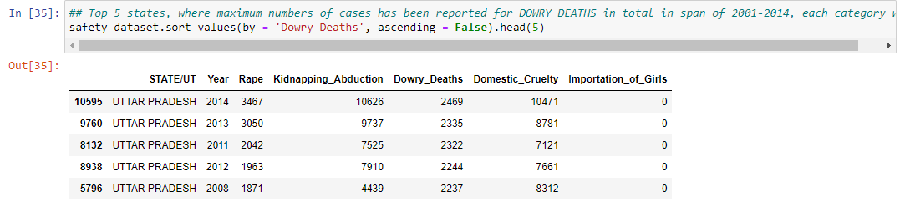
Top 5 states, where maximum numbers of cases has been reported for DOWRY DEATHS in total in span of 2001-2014
Inference:Uttar Pradesh has reported the highest number of Deaths caused by Dowry cases in TOTAL in span of 2001-2014, where Bihar, Madhya Pradesh, Andhra Pradesh and West Bengal follows the list.

Slide 29
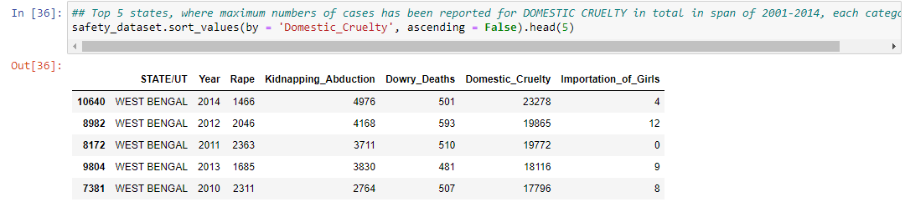
Top 5 states, where maximum numbers of cases has been reported for DOMESTIC CRUELTY in total in span of 2001-2014
Inference: West Bengal has reported the highest number of cases of Domestic Violence in TOTAL in span of 2001-2014, where Andhra Pradesh, Rajasthan, Uttar Pradesh and Maharashtra follows the list.

Slide 30
AND MANY MORE…

Slide 31
FOR FULL PROJECT CLICK THE ICON BELOW

Slide 32
THANK YOU

